Slide 1


BUILD YOUR PERSONAL AI AGENT WITH CLAUDE CODE

Slide 2
PROMPT ENGINEERING

Slide 3

What is Prompt Engineering?
Prompt engineering is the practice of designing and optimizing text input to generative AI models to obtain desired responses.
It is the art of communicating with a generative AI model.
“Recommend a book.”
High-quality prompts guide the AI model to generate better outputs.
“Recommend a fiction book.”
© All rights reserved for Dr. Ryan Ahmed @Stemplicity Inc.
“Recommend a historical fiction book set in World War II.”

Slide 4
Prompt Components
Context: Set the scene, who is the AI, what's the situation?
Context:
You are an expert financial analyst.
Instruction: When given a news article, indicate if it’s positive, neural or negative.
Input: “Tesla stock increased today after a successful self driving demo.”
Output: Respond with (1) Sentiment, (2) explanation of why you chose this sentiment.
Context
Instruction: A clear statement of the desired goal.
Instruction
Input Data: The data or content to analyze.
© All rights reserved for Dr. Ryan Ahmed @Stemplicity Inc.
Input Data
Output Indicator: Define the expected format and structure
Output Indicator

Slide 5
Prompting Essentials
Guide behaviour with System Prompt
Set the persona, rules, constraints and output format
Ask for reasoning (Chain of thought):
“explain your steps” or “show the calculation before the result” to build trust and transparency.
Add constraints & boundaries:
Word limits, style guides, or examples help the model aim correctly. “Explain in 3 bullet points, max 15 words each.”
Iterate and refine
The first draft is rarely the final. Treat prompts like a conversation; tweak wording, add detail, narrow scope until the output clicks.
Anchor with examples (Few Shot Prompting):
Show the AI what “good” looks like. A sample answer, tone, or structure is worth paragraphs of instructions.
Structured Output
Request JSON, XML, or specific formats
Force Model to Avoid Hallucination
“Don’t hallucinate, ground your results in the provided data. If data is missing, say ‘not enough info’ instead of guessing.”
© All rights reserved for Dr. Ryan Ahmed @Stemplicity Inc.

Slide 6
LARGE LANGUAGE MODELS FOUNDATIONS

Slide 7

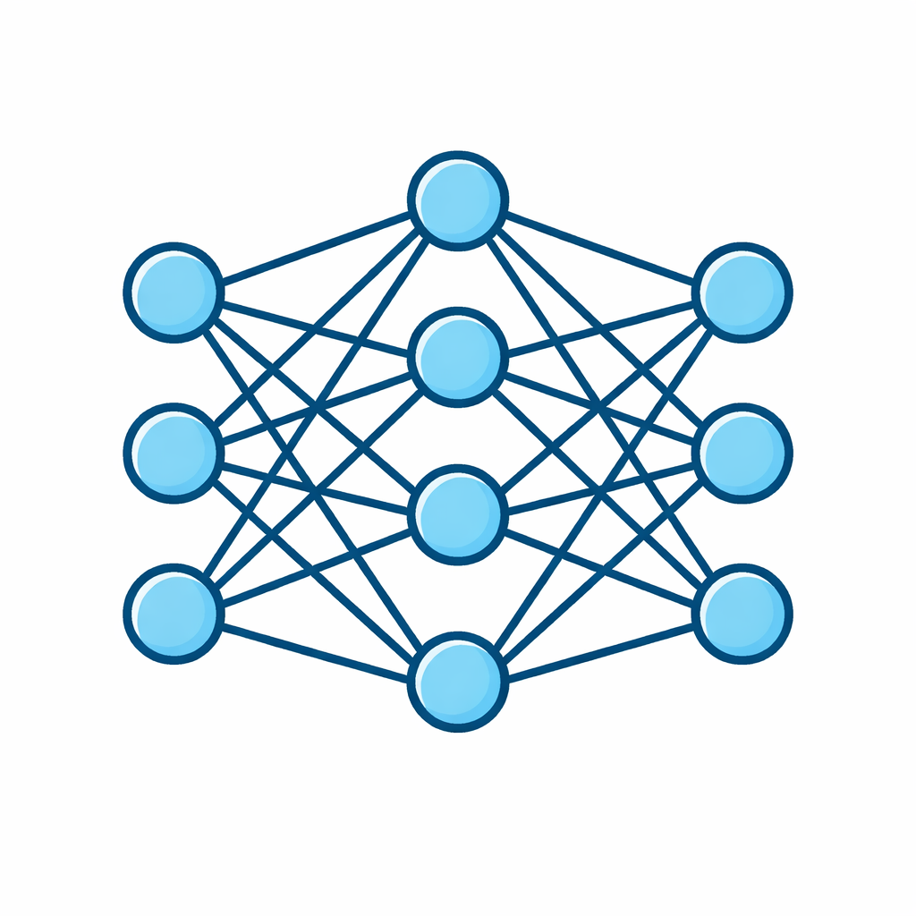
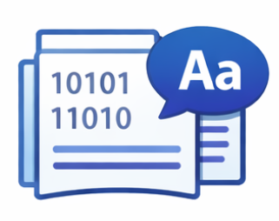
Large Language Models (LLMs)
A Large Language Model is a neural network trained on massive text datasets to understand and generate human language. At its core, it predicts the next most probable token in a sequence.
© All rights reserved for Dr. Ryan Ahmed @Stemplicity Inc.
Training Data
Parameters
Generation
Billions of learned weights that encode language patterns and knowledge
Produces text token-by-token using probability distributions
Billions of tokens from books, web pages, code, and conversations

Slide 8
How LLMs work?
Input Text
Tokenization
Transformer
Layers
Probability
Distribution
Output
Token
Input Text: The user provides a prompt in natural language.
Tokenization: The text is converted into numerical tokens the model can process.
Transformer Layers: The model analyzes token relationships using self-attention to understand context.
Probability Distribution: The model calculates the likelihood of every possible next token.
Output Token: The most likely (or sampled) token is selected and generated as output.
© All rights reserved for Dr. Ryan Ahmed @Stemplicity Inc.

Slide 9
Tokens
Tokens are chunks of text, typically words, subwords, or characters, that the model uses to process and generate language. Understanding tokens is key to managing costs and context limits.
The model doesn't "read" text like humans do. Instead, a tokenizer breaks down the input into these tokens and converts them into numerical IDs the model can understand.
The model then learns relationships between these tokens to predict the next one in a sequence.
Check OpenAI's Tokenizers here: https://platform.openai.com/tokenizer
Example
"Welcome to the Bootcamp!"
→ [“Welcome", “to", " the", " Boot", " camp", " !"] = 6 tokens
© All rights reserved for Dr. Ryan Ahmed @Stemplicity Inc.
~1 token
~750
1M tokens
≈ Entire works of Shakespeare OR
≈ 8 full-length novels
≈ 4 characters
in English
words per
1,000 tokens

Slide 10

Practice Opportunity: Understanding Tokens
Use the OpenAI Tokenizer Tool to analyze the following two prompts. Record the number of tokens for each of the following examples:
Example 1: "Explain the difference between supervised and unsupervised learning in AI."
Example 2: "Please explain the difference between supervised and unsupervised learning in AI. Thank You."
Which sentence had more tokens?
Reflect: Sam Altman once mentioned that people typing “thank you” and "please" to ChatGPT cost OpenAI millions of dollars. What does this tell you about the importance of token efficiency when designing prompts or building tools? (https://futurism.com/altman-please-thanks-chatgpt)
© All rights reserved for Dr. Ryan Ahmed @Stemplicity Inc.

Slide 11
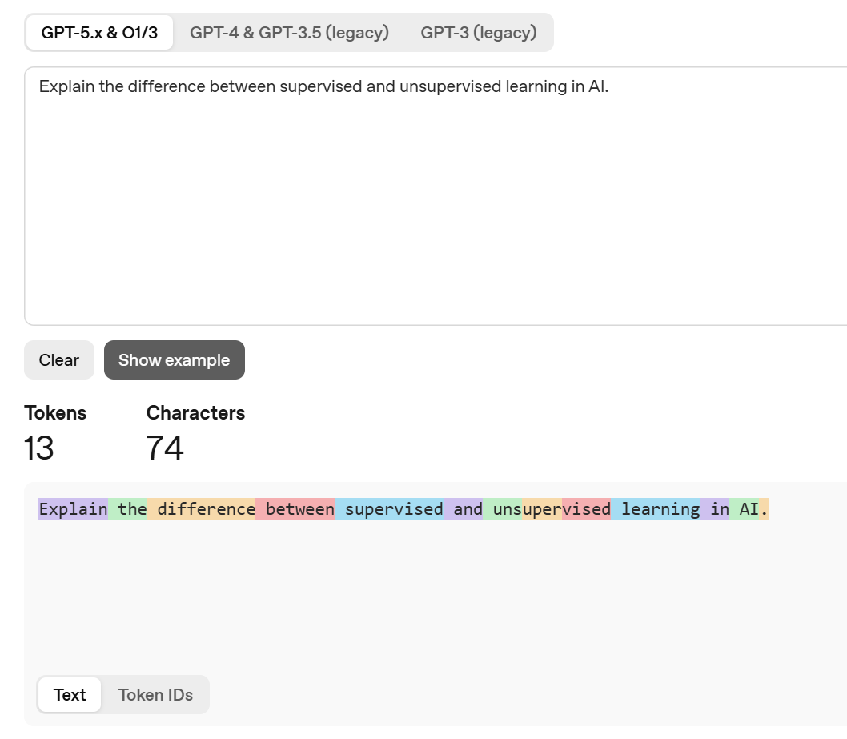
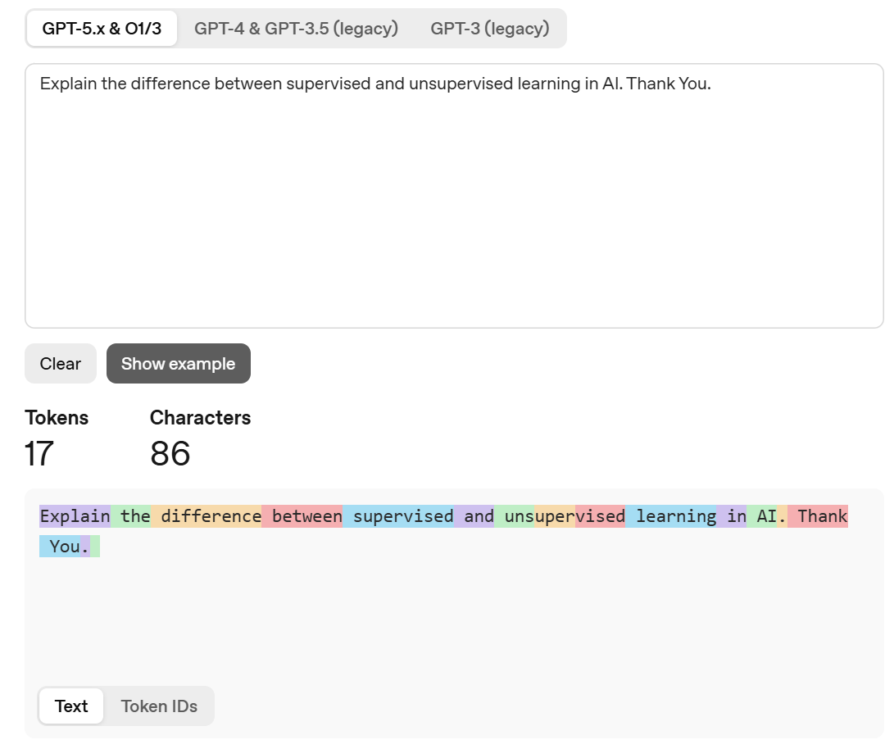
Practice Opportunity Solution
© All rights reserved for Dr. Ryan Ahmed @Stemplicity Inc.

Slide 12
The Context Window
The context window is the maximum number of tokens an LLM can process in a single interaction including both input and output. It defines how much information the model can "see" at once.
GPT-5.4
1M
Claude Opus 4.6
1M
Gemini 3.0
1M
Llama 4 Maverick
10M
© All rights reserved for Dr. Ryan Ahmed @Stemplicity Inc.
Why it matters
Larger context = more documents, longer conversations, and complex tasks.
Model | Tokens
128K | ~300 pages
400K | ~1,200 pages
1M | ~2,500–3,000 pages
10M | Entire codebase / archive

Slide 13
Thank you!

